Slide 1
Deep Learning Application to Classify COVID-19 X-rays
Presented By:
NS S. M. Waqas Ali
Advisor:
Sqn Ldr Dr. Ammar Saleem
Number of Slides:
36
Co-advisor:
Sqn Ldr Dr. Nayyer Aafaq

Slide 2
Sequence
Motivation
Project Scope
Project Deliverables
Literature Review
Dataset
Methodology
Project Deliverabkes Checklist
Platforms Used
Future Tasks
Resources Required
Future Tasks
References

Slide 3
Motivation
December 2019
End of June 2020
In just a matter of months, the number of confirmed cases increased exponentially. ^{[1]}
Dire need of speeding up the process of detecting positive patients of COVID 19 in hospitals.
First case reported
1,334,633 confirmed cases ^{[1]}
36,355 deaths ^{[1]}

Slide 4
Scope
“Emergent need to develop a Chest X-ray (CXR) image-based disease classification to aid to the diagnosis of COVID 19”

Slide 5
Project Deliverables
01
02
03
Basic software plan
Preliminary results
Development of application
DNN choice
Training data
Validation accuracies
Training curves
Loss curves
GUI
Testing

Slide 6
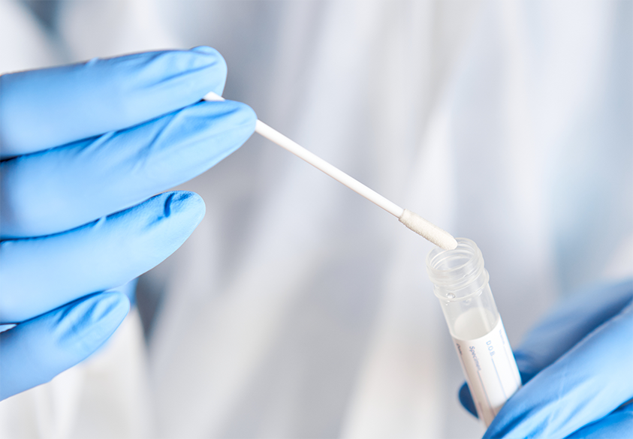
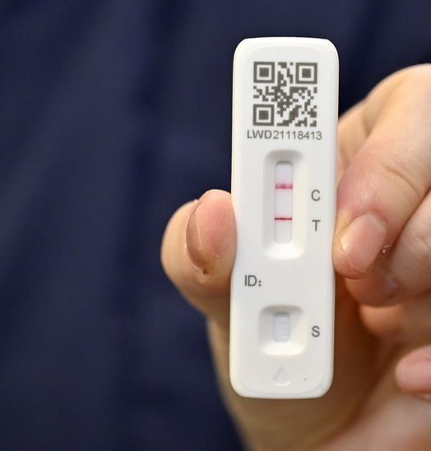
Literature Review
Tools available for detection
Source: https://www.oraldna.com/
Source: www.bbc.com/news
RT-PCR
LFT
Expensive
Results take longer
Dangerous
Inaccurate
A research showed among known COVID-19 patients, LFT identified only 49% ^{[2]}.

Slide 7
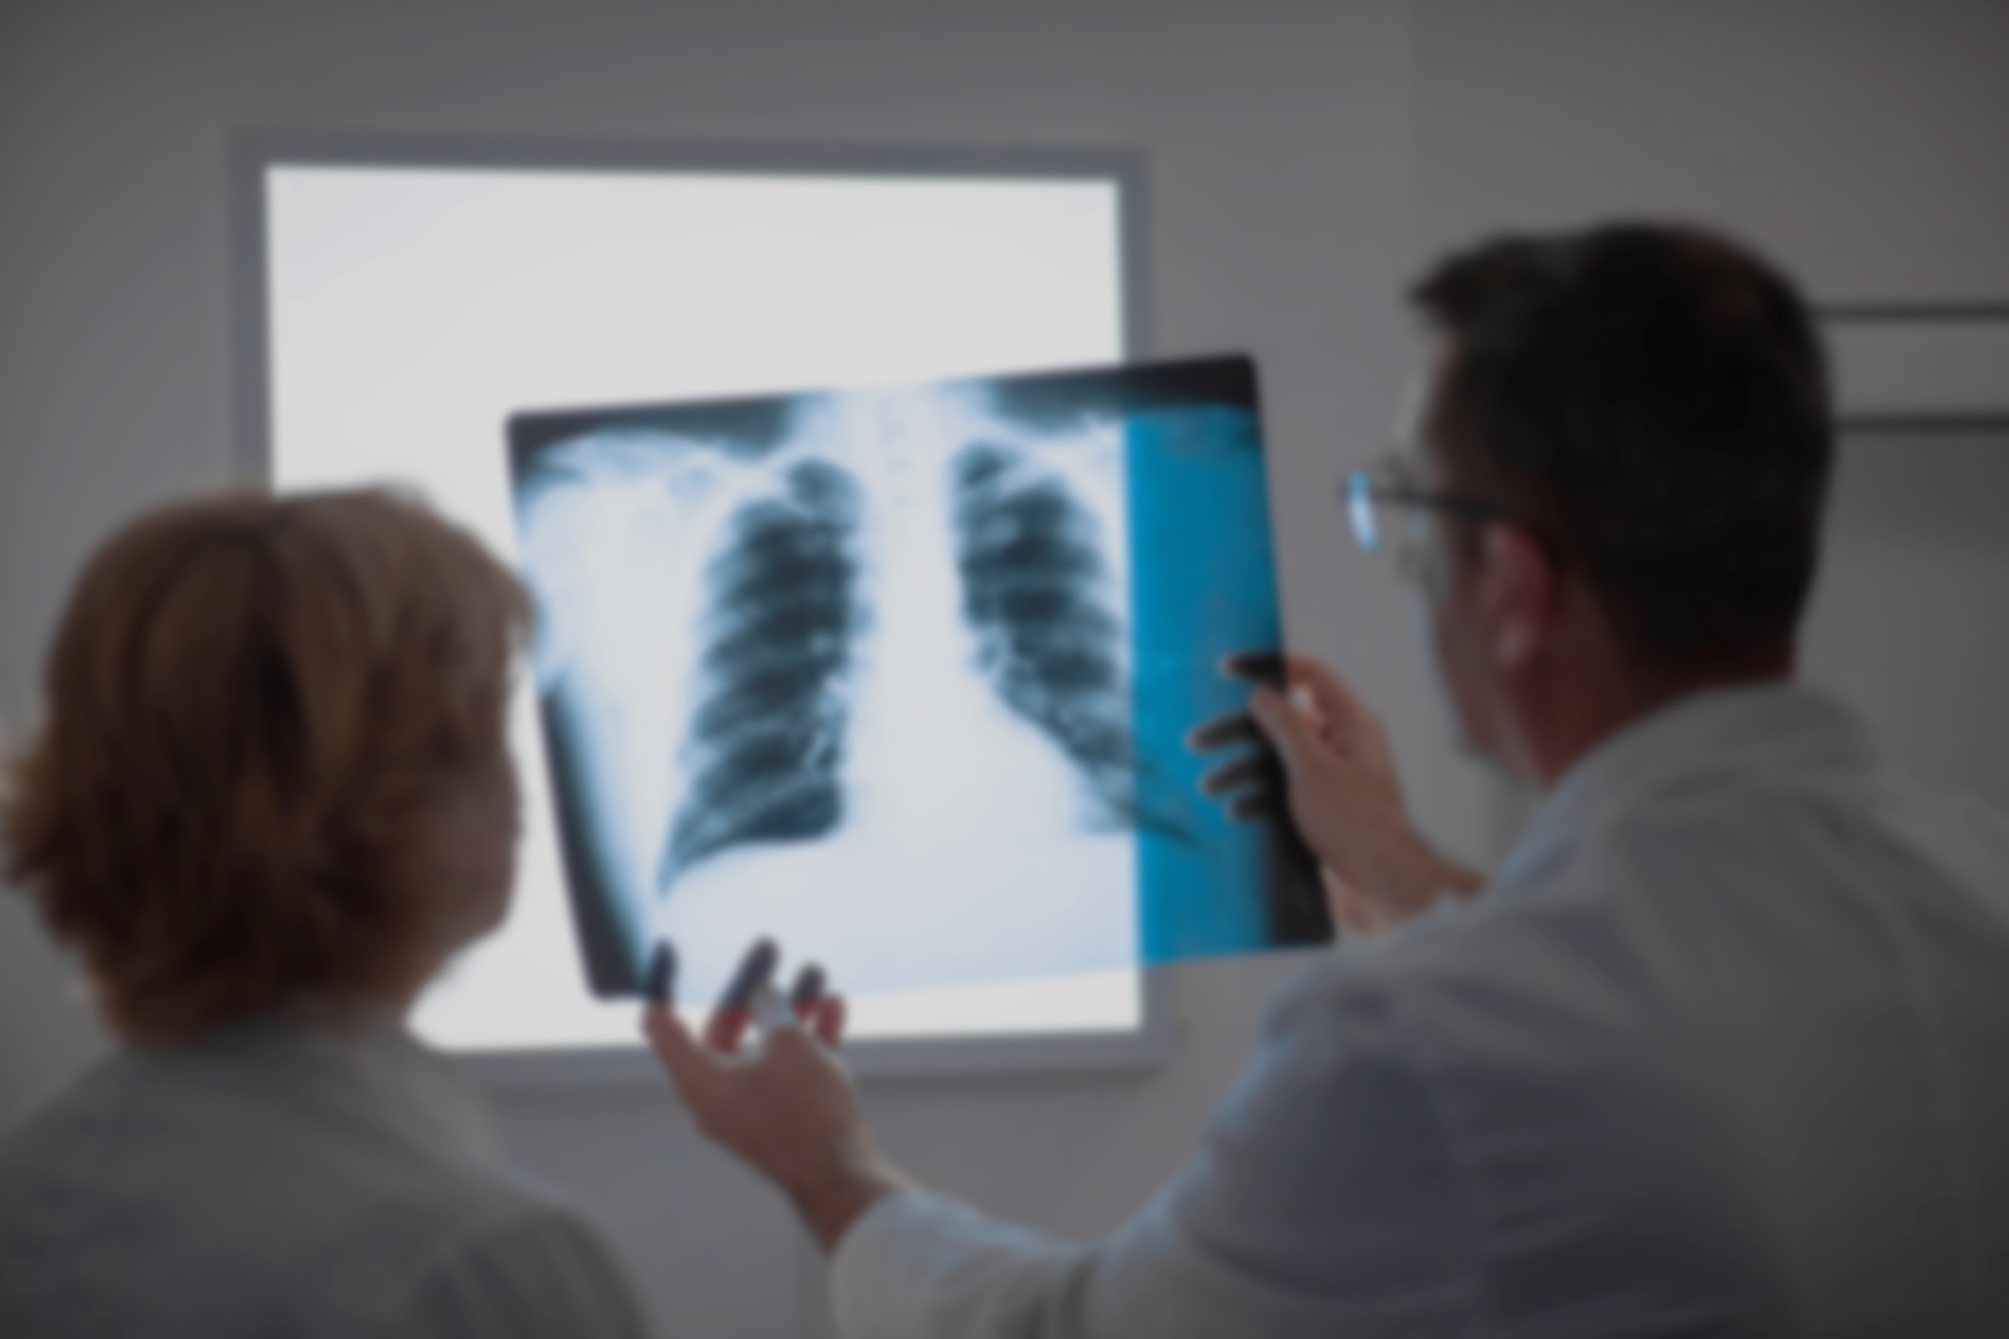


Deep Learning: A new detection method
Available tools not feasible (Increasing demand)
Quicker and accurate diagnosis
Precious resources saved
Background Photo Source: https://www.lungcancercenter.com

Slide 8
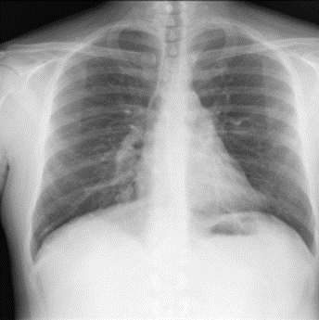
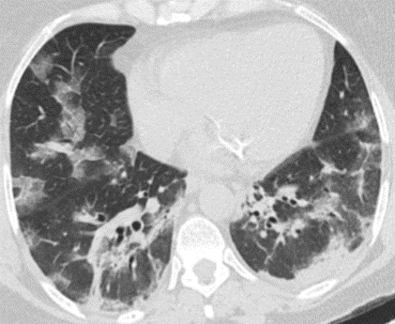
Literature Review
Why Chest X-Ray?
Why not CT Scan?
Source: COVID-19 Chest Radiography dataset^{[3]}
Source: Soares et. al. ^{[4]}
Readily available
Portable
Part of a standard procedure in every hospital
Heavy and costly
Takes large space
Not portable (Fixed)

Slide 9
Literature Review
To date, researchers have been successful in detecting COVID 19 from Chest X Rays using various methods of deep learning
Paper | Best Model | Validation Accuracy | Dataset
Kubra et al. ^{[5]} | SqueezeNet | 90.95% | ChestX-Ray14
M. E. H. Chowdary ^{[6]} | DenseNet-201 | 98.80% | COVID-19 Chest Radiography Database^{[3]}
S. R. Abdani et al. ^{[7]} | SPP-COVID-Net | 94.60% | COVID-19 Chest Radiography Database^{[3]}
Amel et al. ^{[8]} | ResNet-34 | 98.34% | COVID-19 Chest Radiography Database^{[3]}
Vipul et al. ^{[9]} | MobileNet-V2 | 96.4% | SARS-CoV-2 CT-scan dataset
Table 1: The results of existing literature

Slide 10
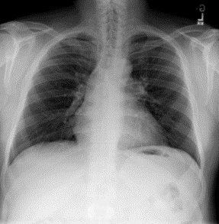
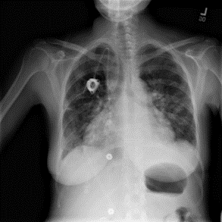
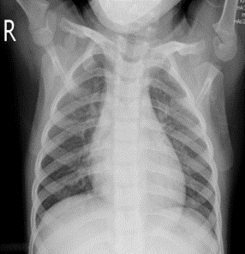
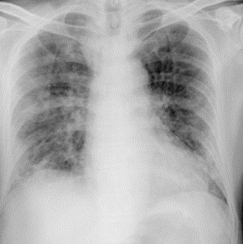
COVID-19 Chest Radiography dataset^{[3]}
Dataset
21165 images (RGB (299x299)
3616 COVID-19 CXRs
10192 Normal CXRs
6012 Lung Opacity CXRs
1345 Viral Pneumonia
Source: Samples from COVID 19 Chest Radiography Database

Slide 11
Methodlogy
Project
Phase 1
Phase 2
Pre-processing
Training
GUI
Integration and Testing

Slide 12
Phase 01
Model Training and Evaluation

Slide 13
Phase 1
Preprocessing
Reshape
Reshaping from 299x299 to 224x224
Gray-scaling
Improving contrast
Histogram Equalization (HE)
Improves overall contrast of CXRs
Contrast Limited Adaptive HE (CLAHE)
Improves contrast around ribs and collar bones

Slide 14
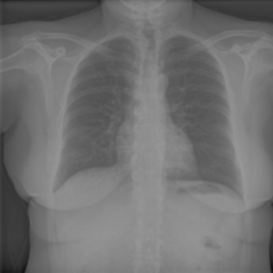
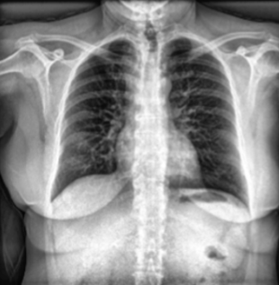
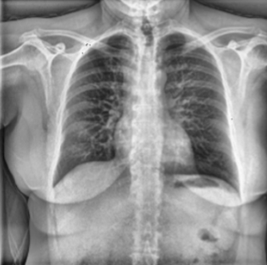
Phase 1 (Continued)
Images at each step of preprocessing
HE
Input
224x224
Output
299x299
224x224
CLAHE
Reshaping to 224X224
Source of Input Image: COVID-19 Chest Radiography dataset^{[3]}

Slide 15
Phase 1 (Continued)
Choice of DNN
Convolutional Neural Network
Lower number of parameters
Required lesser computation power
Enables Transfer Learning
Designed specifically for Image processing and object detection
Comparison with other classifiers (Image Processing) ^{[10]}
CNNs had 99% accuracy
SVMs had 91% accuracy

Slide 16
Phase 1 (Continued)
Choice of Network Architecture
Family of ResNet architectures
Performs best is existing literature
Shows promising results
Comparison with other network architectures ^{[8]}
Model | Accuracy (%)
VGG-19, DenseNet-201 | 90
COVID-PEN | 96
DenseNet-201 + ResNet50V2 + InceptionV3 | 91.62
VGG19, ResNet152Xception | 96
ResNet-34 | 98.34
Table 2: Comparison of ResNet-34 with other architectures ^{[8]}

Slide 17
Phase 1 (Continued)
ResNet Architecture
Family of ResNet architectures selected for research
Model | Number of parameters (in millions)
ResNet-50 | 25.6
ResNet-101 | 44.5
ResNet-152 | 58.5
ResNet-200 | 63
Additional Architectures selected for comparison
Model | Number of parameters (in millions)
EfficientNetB7 | 66
EfficientNetB6 | 43
InceptionV3 | 25

Slide 18
Training
Splitting the dataset
9398 (Training)
85%
11057 (Training)
80%
15%
1659 (Validation)
13822 CXRs
(COVID + Normal)
20%
2765 (Testing)
Batch size of 32 Images
294 steps per epoch
Each epoch means 9398 images for training
The model was trained on 10 epochs

Slide 19

Training
Activation Function Sigmoid was chosen
Classification Problem
Loss function Binary Cross-entropy
Only two number of classes
Optimizer chosen was Adam Optimizer
Optimized for Tensorflow and Keras libraries
Computationally low power required
Source: https://towardsdatascience.com/

Slide 20
Results
The summary of validation accuracies
Model | Validation Accuracy (%)
ResNet-50 | 88.43
ResNet-101 | 78.30
ResNet-152 | 85.47
ResNet-200 | 75.83
EfficientNetB7 | 67.63
EfficientNetB6 | 76.97
InceptionV3 | 79.26
Table 3: Summary of results

Slide 21
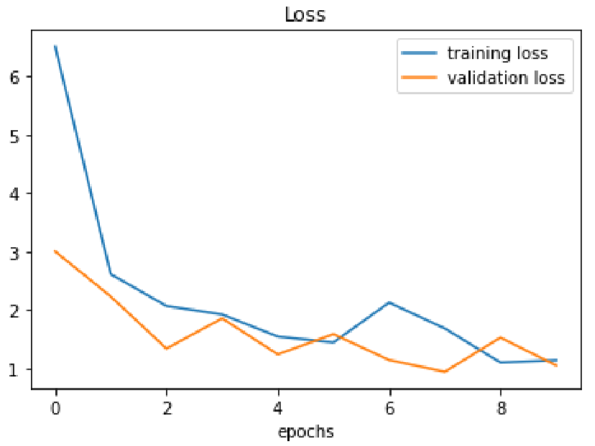
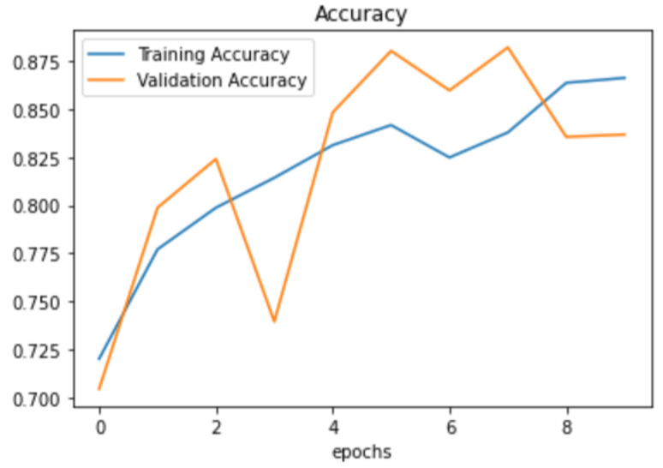
Results
ResNet-50 performed the best with a validation accuracy of 88.43%.
Figure 1: Loss Curve for ResNet-50
Figure 2: Training Curve for ResNet-50

Slide 22

Results (Continued)
Evaluation Metrics and Confusion Matrix resulting from testing of ResNet-50
 | Normal (True) | COVID-19 (True)
Normal (Predicted) | 1822 (TP) | 210 (FP)
COVID-19 (Predicted) | 208 (FN) | 525 (TN)
Metric | Value (%)
Recall | 89.75
F1-Score | 89.70
Precision | 89.66
Accuracy | 84.88
Table 4: Confusion Matrix
Table 5: Evaluation Metrics

Slide 23
Development of Application
Phase 02

Slide 24
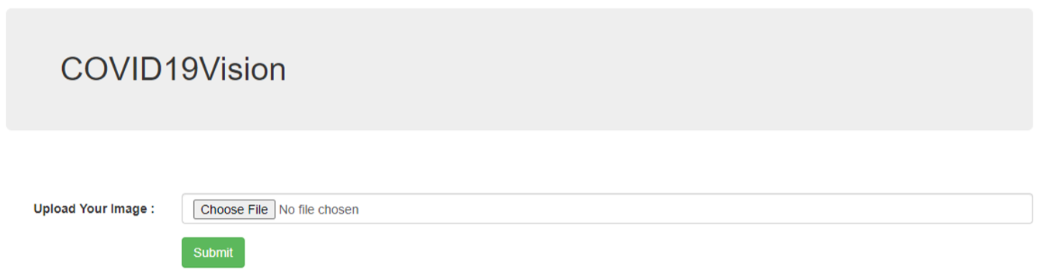
Phase 2
Development of Application: COVID19Vision
Application was built using Flask micro-web framework
Input: Image
Output: Predicted class with associated probability
Figure 3: The Graphical User Interface of COVID19Vision

Slide 25
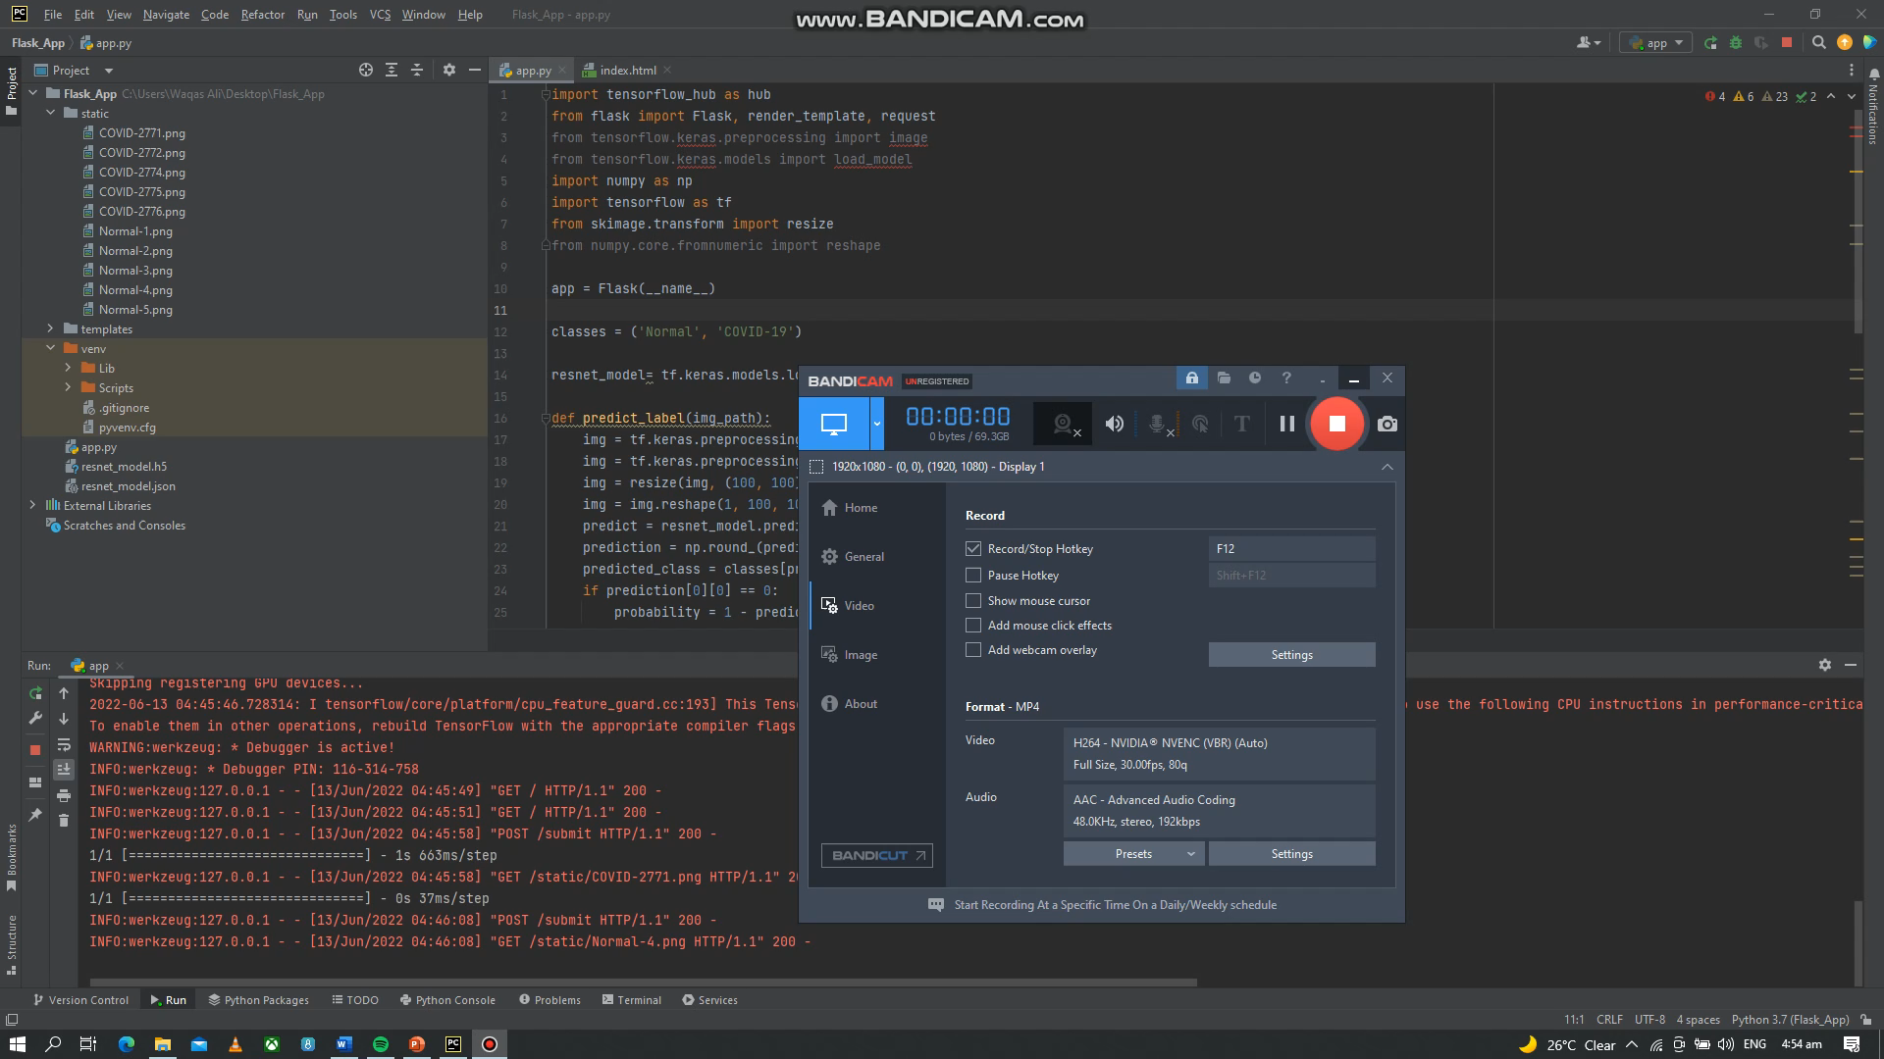
Phase 2
Working of COVID19Vision
Video 1: The video shows how COVID19Vision works

Slide 26
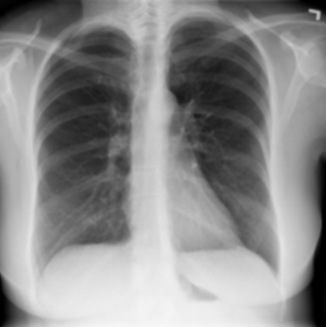
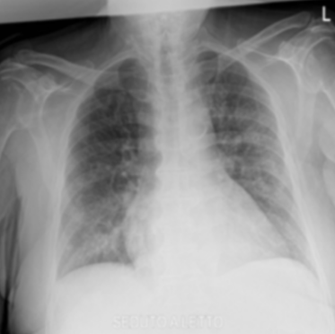
Phase 2 (Continued)
Testing on Test Data
Actual Class: Normal
Actual Class: COVID-19
Predicted Class: Normal
Probability: 98.51%
Predicted Class: COVID-19
Probability: 99.72%
Source of Input Image: COVID-19 Chest Radiography dataset^{[3]}

Slide 27

Project Deliverables: Checklist
01
02
03
Basic Software Plan
Preliminary Results
Development of Application
DNN Choice
Training data
Validation Accuracies
Training curves
Loss curves
GUI
Testing

Slide 28



Platforms Used
Google Colab Pro
PyCharm
Intel(R) Xeon(R) CPU @ 2.00 GHz
NVIDIA Tesla T4 70W
Flask
Micro-Web Framework

Slide 29
Future Tasks

Slide 30
Future Tasks
Problems with Binary Classes
Viral Pneumonia and COVID-19 symptoms alike
A fine line between COVID-19 and Viral Pneumonia CXR Patient
Model with binary classes not feasible for use in medical institutions
Wrong diagnosis of Pneumonia and COVID-19
Wastes valuable resources

Slide 31
Future Tasks (Continued)
COVID-19
Normal
Classes
Lung Opacity
Viral Pneumonia

Slide 32
Future Tasks (Continued)
Increase the number of classes
Advantages
Model will be able to classify between Viral Pneumonia and COVID-19
No wrong diagnosis
Save valuable resources
Ventilators
Beds
Medical Resources

Slide 33
Refrences
[1] Covid19.who.int. 2022. WHO Coronavirus (COVID-19) Dashboard. [online] Available at: <https://covid19.who.int/> [Accessed 23 August 2022].
[2] Wise, Jacqui. "Covid-19: Lateral flow tests miss over half of cases, Liverpool pilot data show." (2020).
[3] Link: https://www.kaggle.com/datasets/tawsifurrahman/covid19-radiography-database
[4] Soares, Eduardo, Plamen Angelov, SarahBiaso, Michele Higa Froes, and Daniel Kanda Abe. ”SARS-CoV-2 CT-scan dataset: A large dataset of real patients CT scans for SARS-CoV-2 identification.” MedRxiv (2020).
[5] Akpinar, Kubra Nur, Secil Genc, and Serap Karagol. ”Chest X-ray abnormality detection based on squeezenet.” In 2020 international conference on electrical, communication, and computer engineering (ICECCE), pp. 1-5. IEEE, 2020.
[6] M. E. H. Chowdhury et al., ”Can AI Help in Screening Viral and COVID-19 Pneumonia?,” in IEEE Access, vol. 8, pp. 132665-132676, 2020, doi: 10.1109/ACCESS.2020.3010287.
[7] S. R. Abdani, M. A. Zulkifley and N. Hani Zulkifley, ”A Lightweight Deep Learning Model for COVID-19 Detection,” 2020 IEEE Symposium on Industrial Electronics & Applications (ISIEA), 2020, pp. 1-5, doi: 10.1109/ISIEA49364.2020.9188133.

Slide 34
Refrences
[8] Ksibi, Amel, Mohammed Zakariah, Manel Ayadi, Hela Elmannai, Prashant Kumar Shukla, Halifa Awal, and Monia Hamdi. ”Improved Analysis of COVID-19 Influenced Pneumonia from the Chest X-Rays Using Fine-Tuned Residual Networks.” Computational Intelligence and Neuroscience 2022 (2022).
[9] Singh, Vipul Kumar, and Maheshkumar H. Kolekar. ”Deep learning empowered COVID-19 diagnosis using chest CT scan images for collaborative edge-cloud computing platform.” Multimedia Tools and Applications 81, no. 1 (2022): 3-30.
[10] Add DNN choice refrence

Slide 35
Thank you

Slide 36
Any questions?

